Slide 1


Hisense HiMod chiller

Slide 2
Hi Mod
Műszaki adatok
Model |  |  | HFRWVE-65SPF/AE | HFRWVE-130DPF/AE
Cooling capacity |  | kW | 63 | 126
Heating capacity |  | kW | 68 | 136
COPc/COPh |  |  | 2.85/3.04 | 2.9/3.05
SEER |  |  | 4.71 | 4.61
SCOP（average，Outlet 45℃） |  |  | 2.87 | 2.91
Capacity adjustment of single unit |  |  | Inverter stepless
Power supply |  |  | 380V-415V 3N～ 50Hz
Compressor |  |  | DD110 (25HP) enhanced vapor injection scroll compressor from Hitachi, Guangzhou
Compressor quantity |  | set | 1 | 2
Water side HEX type |  |  | Plate HEX
Water side design pressure |  |  | 1.0MPa
Rated water flow |  | m³/h | 11.2 | 22.4
Water resistance(without filter) |  | kPa | 35 | 35
Water resistance(with filter) |  | kPa | 45 | 45
Pipe diameter(inlet/outlet) |  | — | G2-1/2 External thread（DN65）
Fan | Type | — | Low noise DC variable frequency axial flow fan
 | Air flow rate | m³/h | 24400 | 43000
 | QTY | set | 2 | 2
Refrigerant | Type | - | R410A
 | Total charge | kg | 15.5 | 2*14
Outline dimension | L | mm | 1950 | 2190
 | W | mm | 765 | 1100
 | H | mm | 1725 | 2360
Weight | Net weight | kg | 490 | 910
 | Operation weight | kg | 510 | 930
Noise dB(A) (sound power level) |  |  | 81 | 84
Noise dB(A) (sound pressure level) |  |  | 68 | 70
Page number format

Slide 3
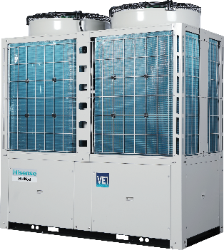
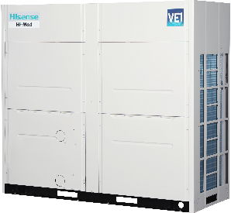
Hi Mod
Bemutató
Product series：Hisense Inverter VE1 series
Minőségi tanusítványok:
EU RoHS 2.0, WEEE
CE
HFRWVE-65SPF/AE
HFRWVE-130DPF/AE
Model | HFRWVE-65SPF/AE | HFRWVE-130DPF/AE
Hűtő teljesítmény | 63kW | 126kW
Fűtő teljesítmény | 68kW | 136kW
Compresszor | Inv | Inv
Fűtési üzemmód
Hűtési üzemmód
Page number format

Slide 4

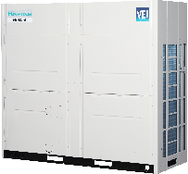
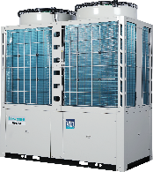
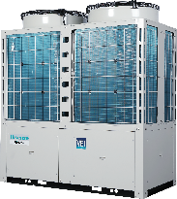
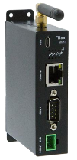
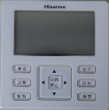
Hi Mod
Szabad kombinációk, intelligens vezérlés
16 modul;
Frekvencia szabályzás 20 and 100 %
Standard RS-485 komunikációs adapter
Opcionnális Távvezérlő egység ( APP and web remote control).
IoT cloud platform (a jövőben)
Chiller cloud platform
Könnyen telepíthető rendszer
Távoli elérés: gateway
(bevezetés alatt)
LTE wireless network, wired hálózat támogatás
Fali vezérlő
Page number format

Slide 5
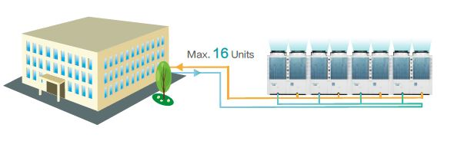
Hi Mod
Kombináció
16 Egység : Teljesítmény 65 - 2085 Kw
Page number format

Slide 6
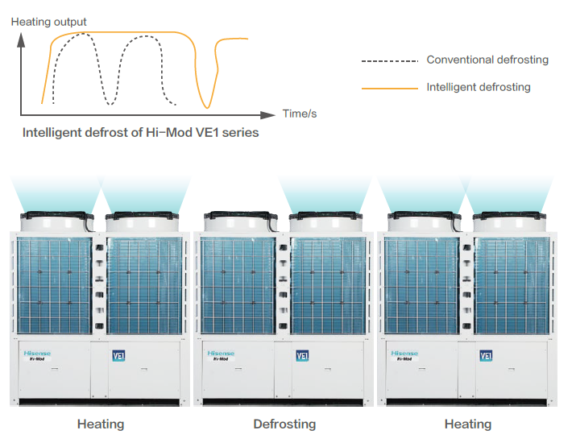
Hi Mod
Smart defrost ( „okos leolvasztás”) technológia
The fin heat exchanger is equipped with dual temperature sensors, which can accurately determine the frosting state, and intelligently judge according to the ambient temperature, evaporation temperature and operating time, and defrost in time;
The defrosting time is automatically adjusted to reduce invalid defrosting, prolong the defrosting time, and improve the heating efficiency;
When the modules are combined, the number of defrost systems at the same time can be set from 1 to 16;
Under standard conditions, the longest defrosting interval defaults to 2 hours, which can be adjusted;
The single module is designed as a double fluorine single water system, the water side heat exchanger is shared, and the air side heat exchanger is separated, and the unit load is controlled by the total inlet and outlet water temperature;
The wind side of the dual system is completely separated and can operate independently. Rotational defrosting of the finned heat exchanger of the entire unit is realized.
Page number format

Slide 7
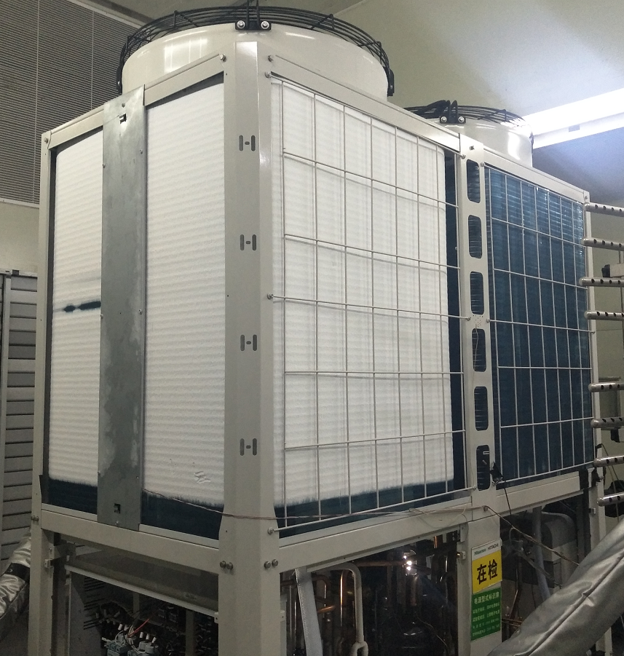
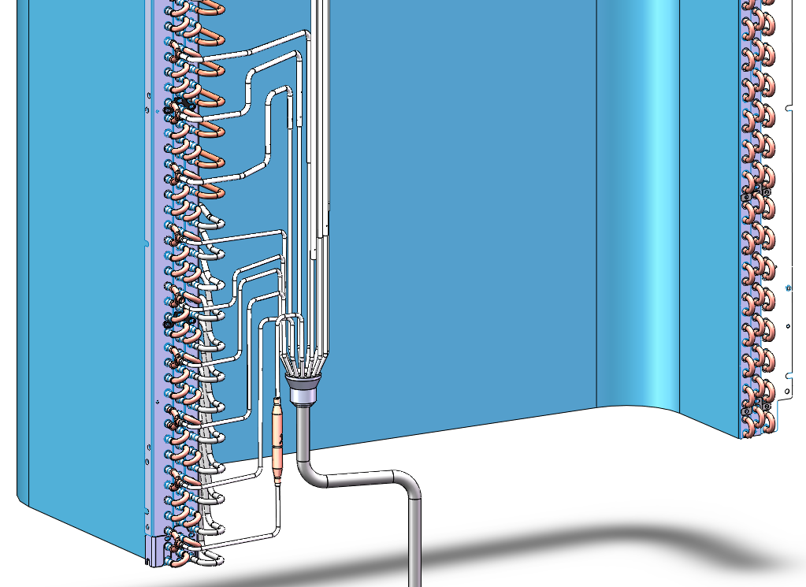
3 Main Components
High Efficiency Finned Condenser
7mm high-efficiency internal thread heat exchange tube, small size and high heat transfer coefficient;
Window-type aluminum fins, hydrophilic coating, slow down the formation of frost, facilitate the rapid removal of defrosted water, and improve heating performance ;
The anti-frost design at the bottom of the heat exchanger can effectively prevent the accumulation of the lower frost layer.
Fin HEX | Type | — | High Efficiency Internal Threaded Pipe
 | Diameter | mm | 7
 | Rows | — | 3
 | Forms | — | Louvered
 | Material | — | Hydrophilic aluminum foil 0.105mm
 | Pitch | mm | 1.7
frost-free bottom
The lowermost branch is provided with a one-way valve, which can circulate during cooling, but not during heating, reducing frost formation.
Hisense
Page number format

Slide 8
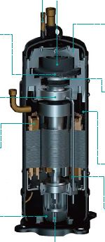

Hi Mod
(1) Betáp
380-415V AC 3N~ 50Hz ;
Megengedett maximális feszültség ingadozás ± 10%
Megengedet 3ph ingadozás alatt 2%.
Fűtési hőmérsékllet
(2) Működési hőmérsékletek
Temp. | Range
Cooling ambient temperature | -15～48℃
Heating ambient temperature | -26～43℃
Outlet temperature of cooling | 5～15℃
Outlet temperature of heating | 35～55℃
(3) Kialakítás
Hitach EVI kompresszor
Economizer
Előnyök:
Tkh= -5°C Twout= 55°C
Tkh= -25°C Twout= 45°C
Page number format

Slide 9
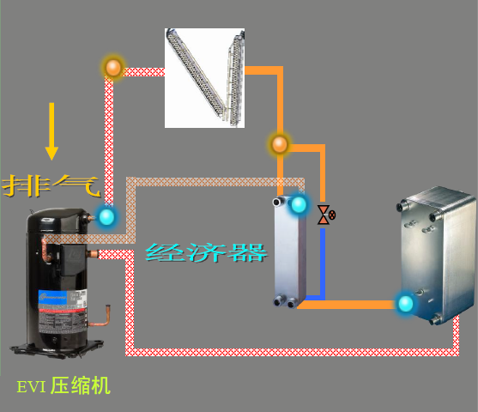
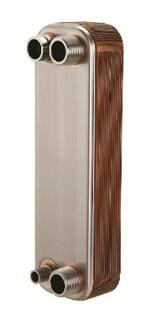

3 Main Components
Economizer
The economizer adopts high-efficiency plate heat exchanger, which is light in weight,
high in heat exchange efficiency and good in reliability;
The economizer adopts the Danfoss brand with first-class quality；
The use of the economizer greatly improves the subcooling degree of the refrigerant
and the energy efficiency ratio of the unit.
Exhaust
Economizer
EVI compressor
Hisense
Page number format

Slide 10
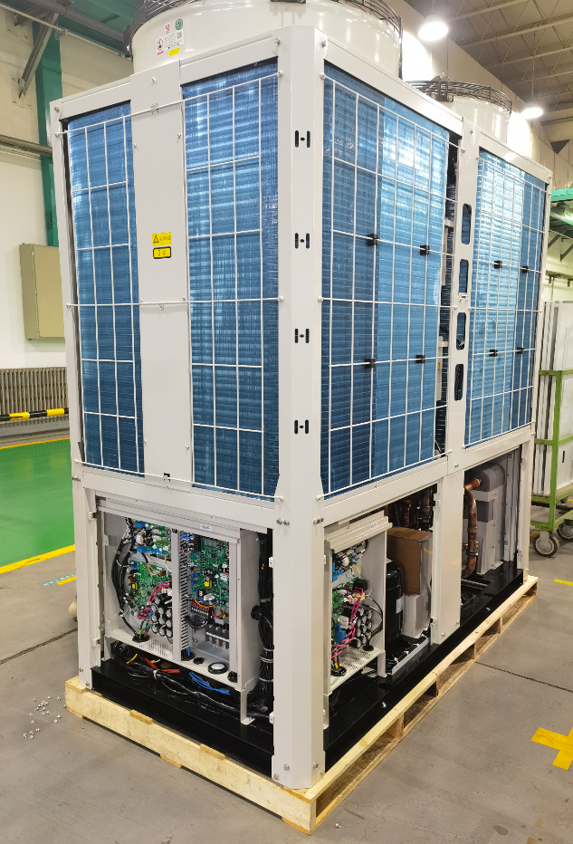
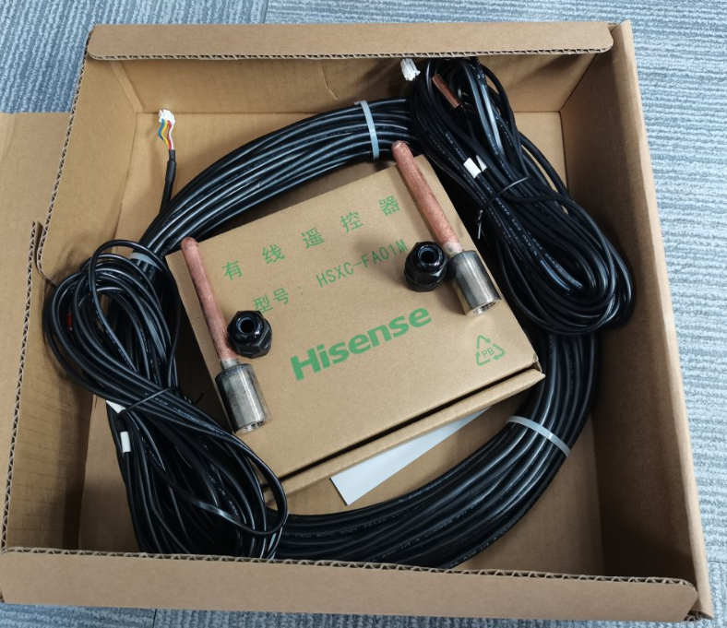
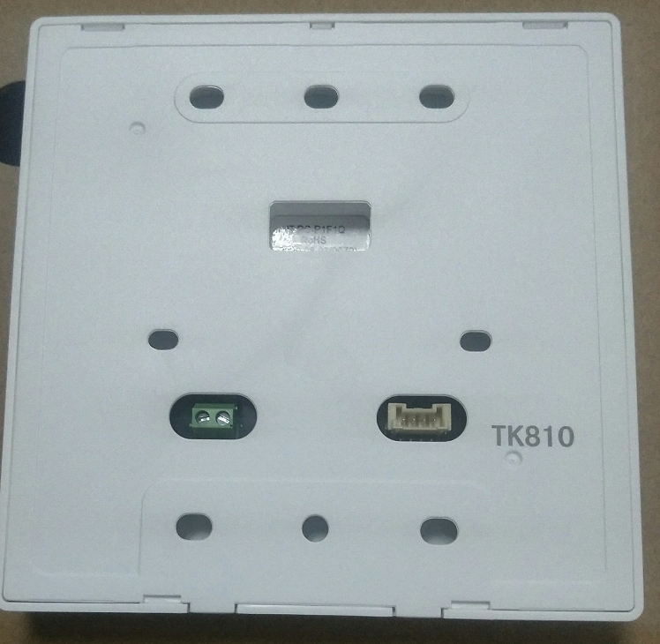
Hi Mod
Tartozékok
Szűrő és víz áramlás őr
Fali vezérlő
Communikációs kábel 30m
Termisztor
RS485 protokol interface
Szenzor rögzítő, 2 sets
Szensor cső, 2 sets
Kommunikációs csatorna
Page number format

Slide 11
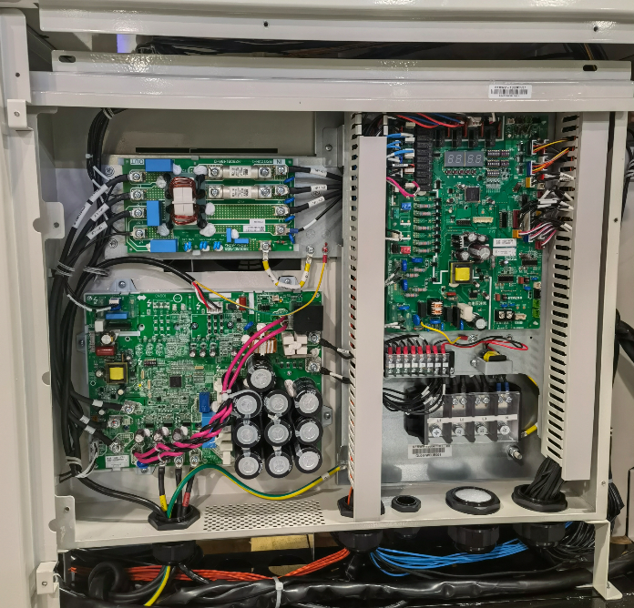
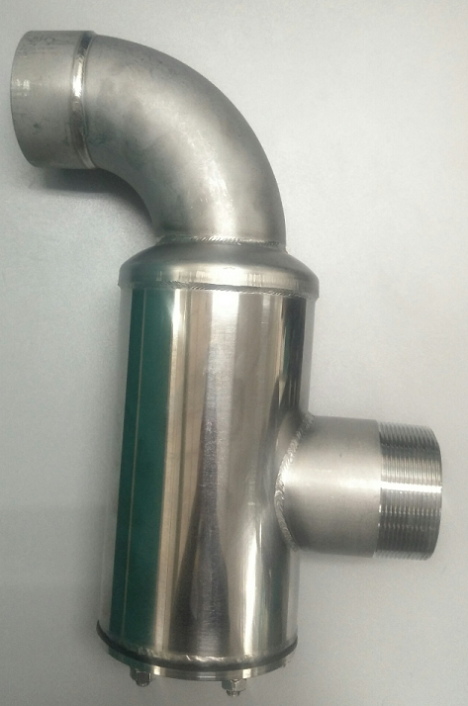
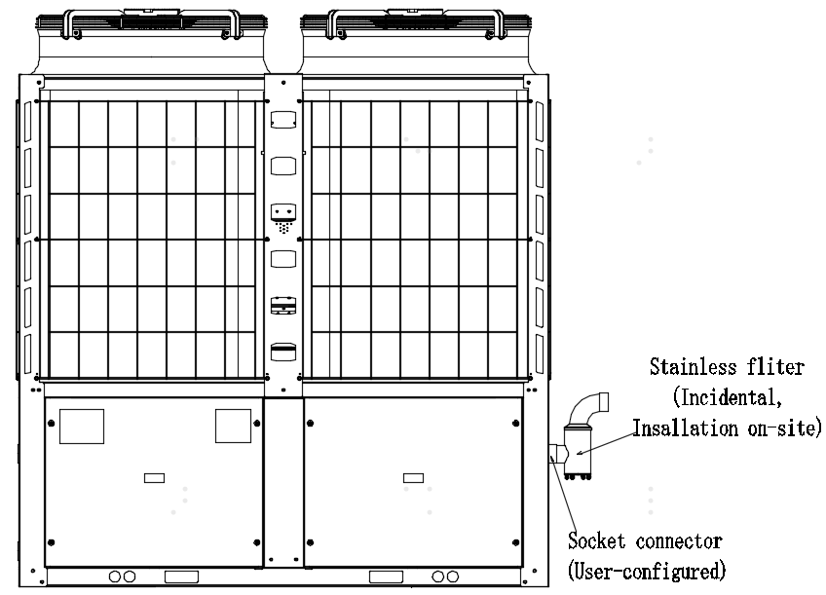
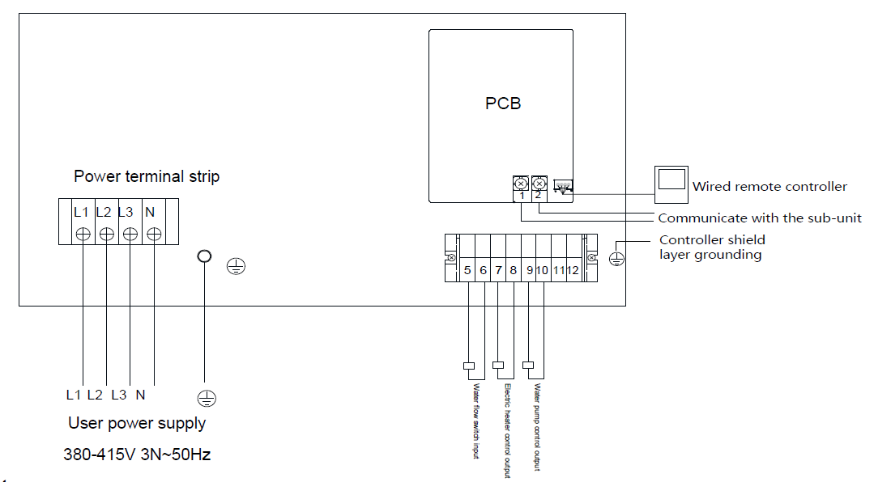
Hi Mod
Víz szűrő
Bekötések
Bemenő
Kimenő
Cserélhető betét
Stainless Steel Water Filter
Page number format

Slide 12
Hi Mod
Elektromos modul
Elektromos egység bekötése
Page number format

Slide 13
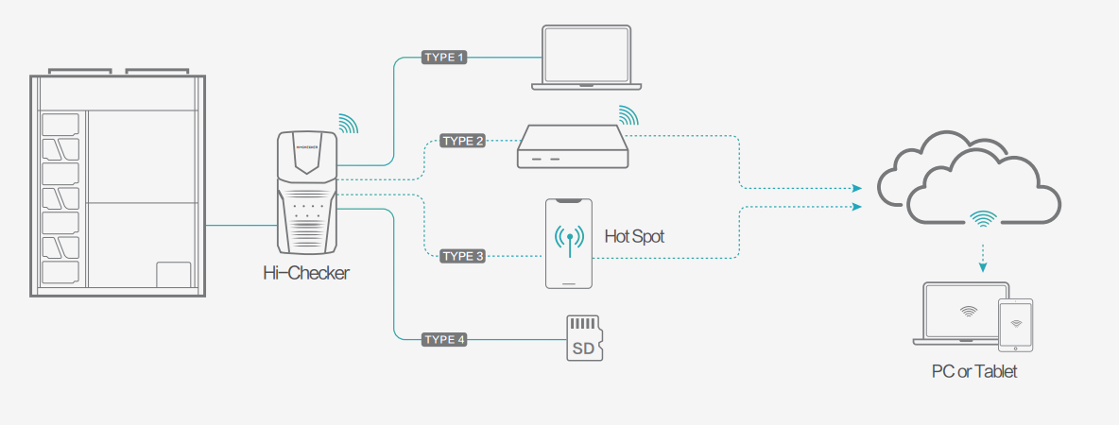
Servíz támogatás
Intelligens szerviz felügyelet: DATA COLLECTOR, Hi Checker
- Üzem információk lekérdezése, beállítások
- Rendszer felügyelet ellenőrzése
- Távoli diagnosztika felmérés és javítás, monitoring
- „Hi Service” mobil applikáció: letölthető a Mobil Apps store-ból ingyen

Slide 14
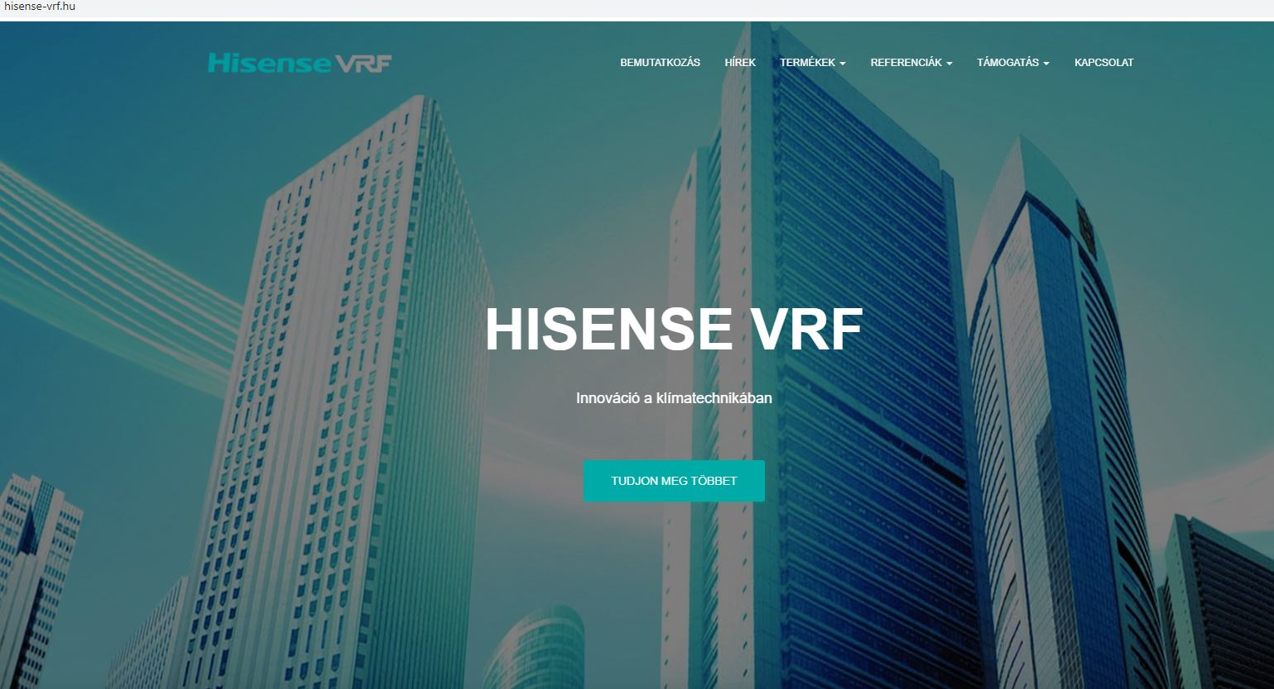

Műszaki és tervezői háttértámogatás
Selection Software
Design software (AutoCAD)
HVAC műszaki támogatás
Web oldalak
www.hisense-vrf.hu
www.hisensehvac.com

